Slide 1
USAF-558 - Supply Chain Communication
Carter Vannelli
Matthew Glos
Ryan Becker
Liuhai Wang
Hao Wang

Slide 2
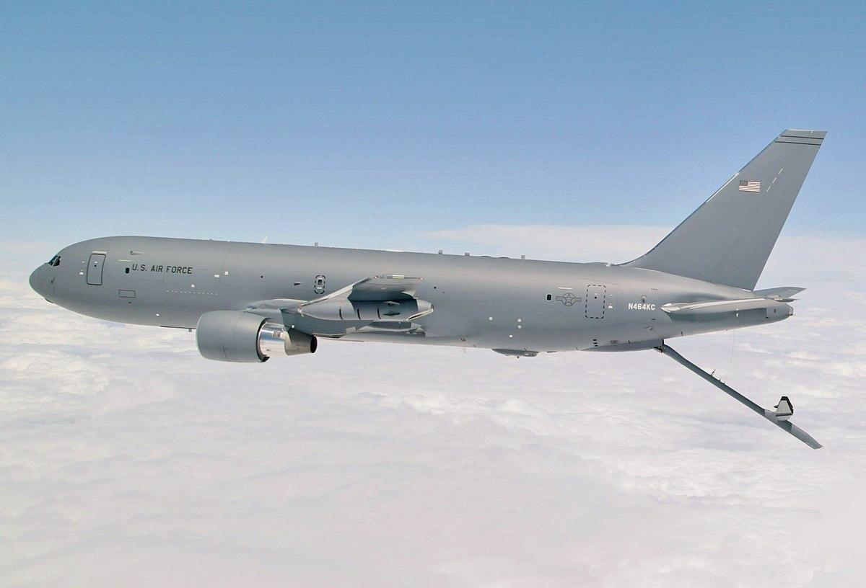
Introduction- Boeing KC-46A Pegasus
Primary operations:
Personnel and cargo transport
Problem:
Part ordering process delays, Missing part number and NSN,
Severe restrictions on unofficial documents and tools,
Low communication efficiency
MVP:
Database Solution
part number- NSN information- relevant data
Notes:
This project focuses on the parts ordering challenges faced by U.S. Air Force KC-46 during Seat Pallet maintenance.
Insufficient technical order (TO) information from third-party vendors, makes it difficult for maintenance personnel to obtain part numbers and National Stock Numbers (NSN) for specific components, resulting in maintenance delays.

Slide 3
Beneficiary Discovery
500+ coworkers email
Site Manager:
Reid Guffey
Daniel P. Schubert
2/20 Phone Interview
Aaron Dangelillo
2/8 Phone Interview
3/28 Phone interview
FSR
Rob Heap (Lead)
Jonathan Bond
Jeff Braskamp
William Church
Donterrio Erby
Mark Owens
James Guffey
Albert Tolbert
Azi Williams
Joshua Cintron Ruiz
FSR Richard Zambori
2/ 25 Email Questionairre
Asantos@bmnt.com,
Hjoudi@bmnt.com
FSR-S
Alex Chien (Lead)
Jesse Boehm
Jeffrey R. Porter
Cancelled

Slide 4
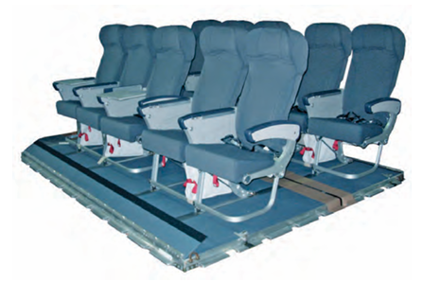
Problem Statement
Certain pallet parts, like the emergency oxygen tank seat pouch, break often.
AAR Mobility does not provide sufficiently detailed TOs to get the specific part number for these parts.
Air Force budgetary constraints do not allow KC-46 Crew chiefs to order the entire seat pallet at once

Slide 5
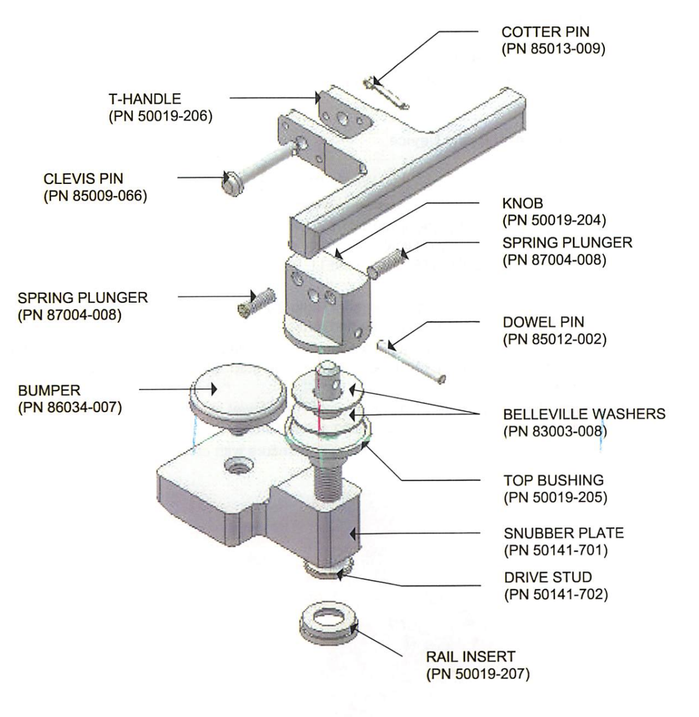
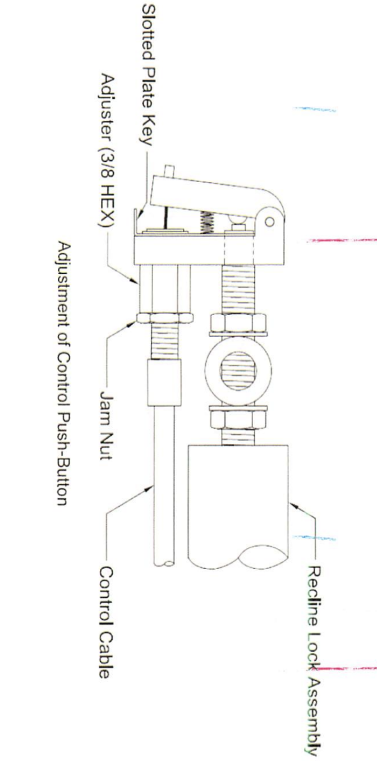
Antirattle diagram

Slide 6
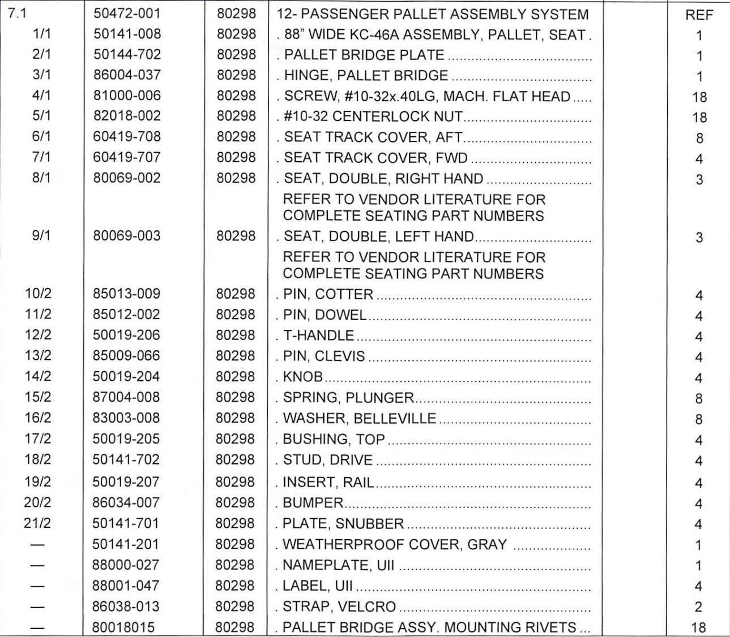

Slide 7
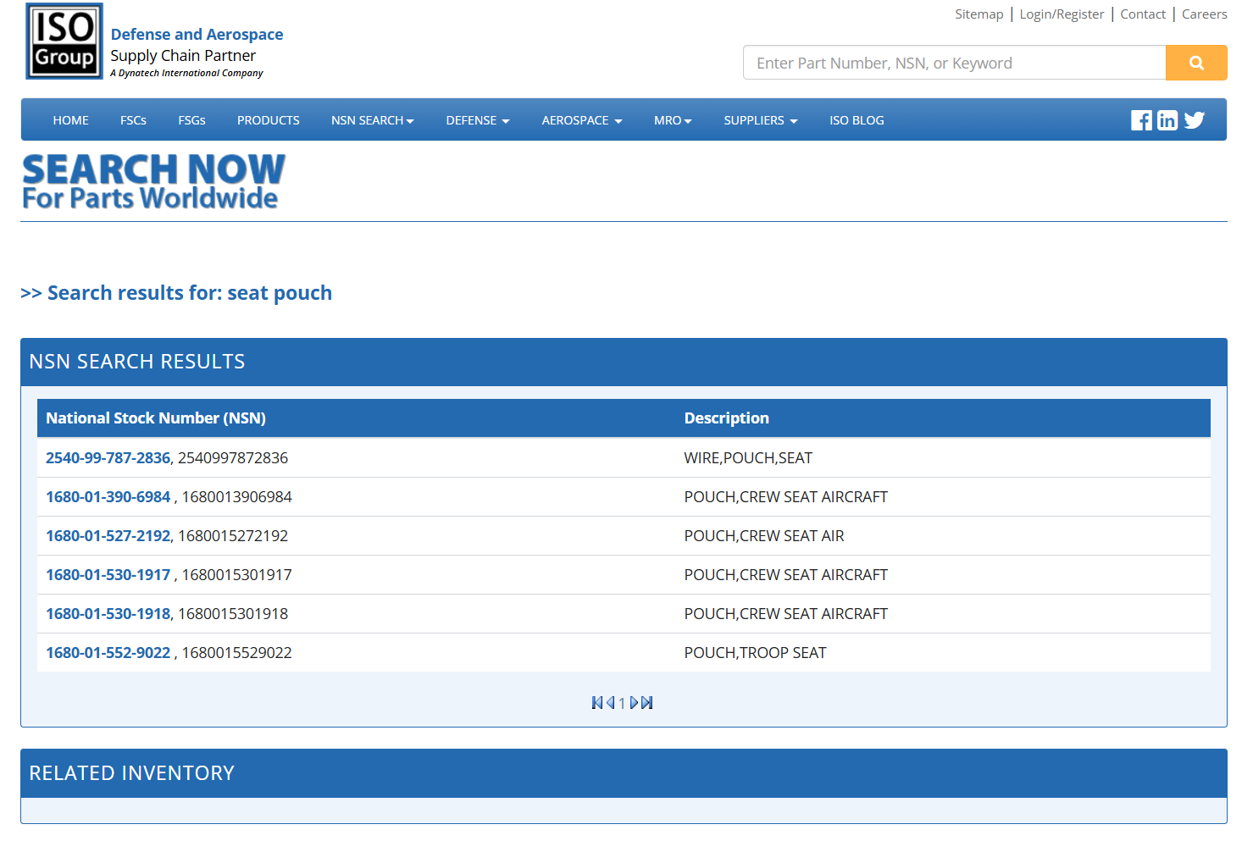

Slide 8
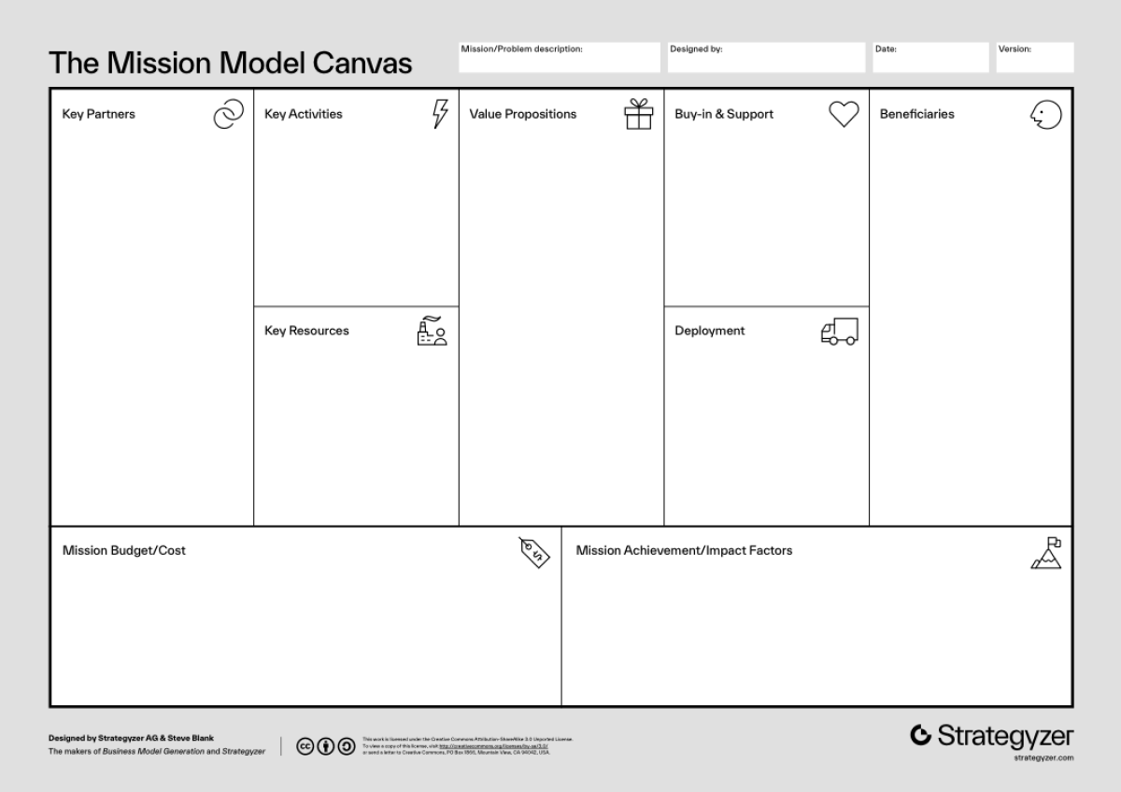
Mission Model Canvas
v5
USAF,
KC-46 Crew,
Defense Logistics Agency,
Air Logistics Centers
Improve the part ordering process
Simplify the collection of PN and NSN to order parts
Improving maintenance efficiency
Enhance inventory management
Improve part delivery reliability
KC-46 Crew,
AAR Mobility Systems
Logistics Squadron,
Dash 21, Flight Crew, Boom Operator,
Crew Chiefs
Improve part number acquisition
10 man and 12 man Seat Pallet TO
G081 ordering system
Streamline parts ordering process, ensure on demand delivery of seat pallets.

Slide 9
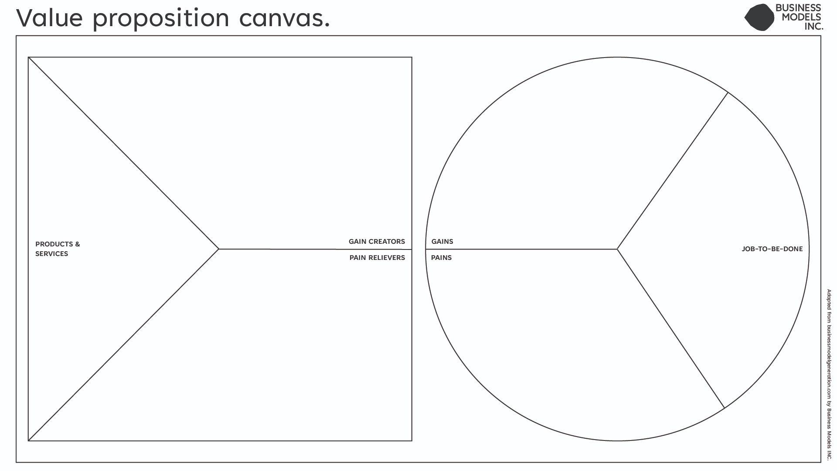
v6
Shorten repair times through a faster and more efficient part procurement process
• Smooth parts delivery service
• Illustrated part breakdown
• Maintain and manage the KC-46 crew
• Timely ordering and receiving of parts
• Optimize inventory management
Part Number acquisition and part number lookup database solution
• Missing technical data
• Slow order processing
• Poor supplier communication
• Inconsistent part availability
• Cannot order just broken seat
• Centralized, complete part number database
• Streamlined ordering system
• Improved digital communication channels
• Predictive stock management
Notes:
• Long procurement times
• Missing part numbers and documentation
• Limited stock, forcing cannibalization of parts
Ordering system not intuitive enough

Slide 10
MVP Database Solution
Whiteboard method - Manually writing down part numbers and associated NSNs used in past orders to simplify the parts part number acquisition process in the future.
Centralizes relevant information to be used more efficiently in the future.
A solution may be to create an improved version of this system, to allow more expedient ordering of parts that need frequent replacement.

Slide 11
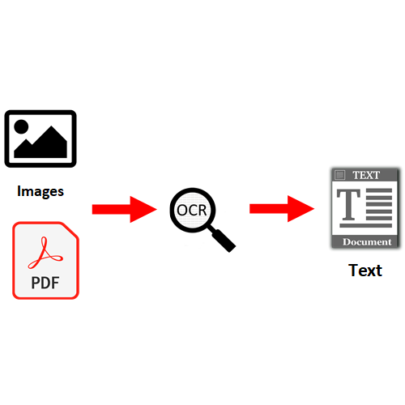
Step 1: OCR
What is it?
Optical character recognition from scanned
images or documents
Commercial Solutions:
Google Cloud Vision
Amazon Textract
Azure Computer Vision OCR

Slide 12
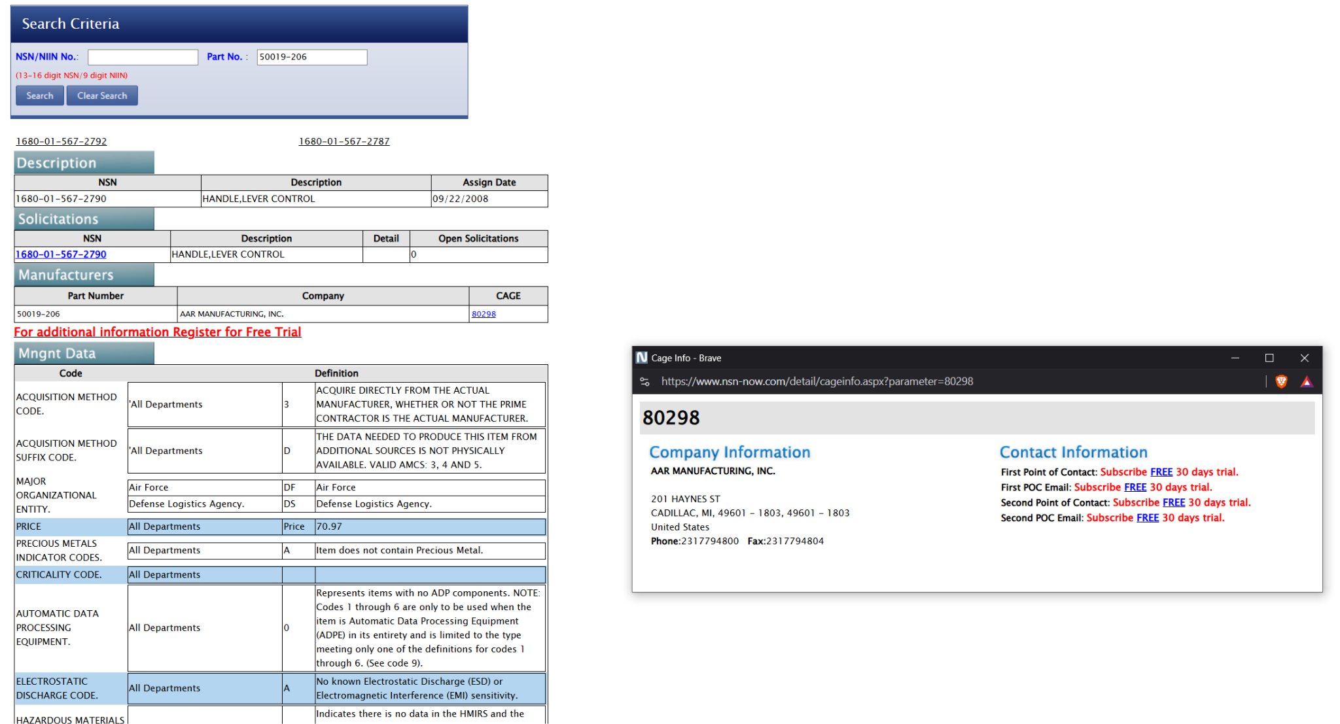
Step 2: NSN Search
What is it?
Static or API leading to obtaining
NSN information from OCR
text formatted data
Commercial Solutions:
ISO Group - too basic
NSN-Now - only public data

Slide 13
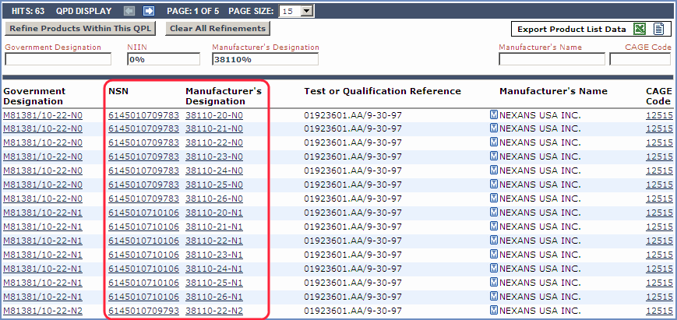
Step 3: Combining and Tracking Data
What is it?
Sort the collected
PN with NSN into table
and other necessary info

Slide 14
Potentially useful Python Libraries
Convert PDF to Image: pdf2image, andPillow
OCR: Tesseract OCR ,OCRMyPDF (adds text layer to PDF), and Calamari OCR (superior quality)
Web request Libs: Requests, Beautifulsoup4, Selenium (headless)
Speedup NSN Request Time: aiohttp, asyncio
Data Handling: Pandas
Database Storage: Sqlite3, Sqlalchemy and PostgreSQL
Vizualization: Matplotlib, Seaborn and Tableau
Formatting: Excel and Latex
OCR
NSN
DATA HANDLE
FORMAT

Slide 15
Outro
MVP:
Database Solution
Objective:
Relieve KC-46 ground crews of routine maintenance pressures
Model solutions for other aircraft types
Explore unofficial tool aids in parallel with the IETM system
Notes:
developed more potential MVP,
(Future Plan)Ask about: more interviews, to comfrim more information and details, and let the interviewer know and judge our MVP. perfect MVP

